Slide 1
CFET defines the future of control system
Control system Framework Experimental Toolkit
Control system For EveryThing

Slide 2
Re Cap

Slide 3

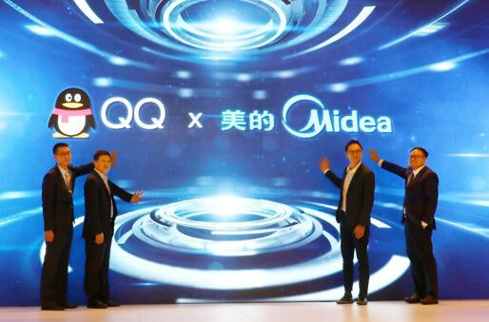
The Most Important Aspect: Interoperability
Many effort seems been put into it. But little have been achieved.
Everybody wants to dominate.
Does not means using the same protocol.

Slide 4
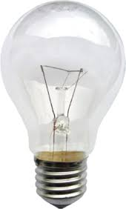
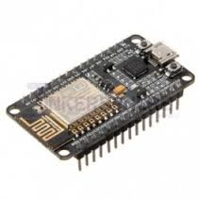
The current IoT approach is wrong
There is no good to give everything an IP address
6Lowpan is limited and meanless
The current protocol are just lies
MQTT is a liar: heavy, needs broker, designed to sell services
CoAP is a joke: like RESTful by not and not compatible and not light
Implementing the above is expensive!
The most popular solution out there is nRF24L, ESP8266
$1
$15

Slide 5
Modeling of things
Status
Read by others changed by self,
by looking at the statuses solely, one can determine all the output and behavior of the thing.
Configuration
Read by self changed by others,
Represent the desired behavior
Method
A command
Event handler

Slide 6
Modeling of things
Resource
Status
Config
Method
Interoperate means: Locate and access resources

Slide 7
Modeling of things
World
Unlimited interoperability is bad

Slide 8
Modeling of things
What is a thing?
Has resources
Can be physical or virtual
Things can aggregate into bigger things

Slide 9
Dumb and Smart Things
Cost!!!!
Dumb thing is god damn cheap!!!
But still interoperable
How?

Slide 10
Dumb and Smart Things

Slide 11
Dumb Protocol Pattern
Language
Identity
Knowledge
Existing protocol can be parsed in the above way

Slide 12
Dumb Protocol Pattern
Bindings:
Static:
The avatar it preconfigure and knows the identity of the dumb things, and have the knowledge of the resource on the dumb things.
Interactive
The avatar is not preconfigured. But when the dumb thing request a bind the avatar is created and the smart device can be recognized the dumb device and then establish the knowledge from pre-configurations or looking up a knowledge base but not from the dumb thing.
Dynamic
The avatar is not preconfigured. When the dumb thing request a bind the avatar the avatar is created and the smart device cannot be recognized. The smart thing cannot establish the knowledge base. It then negotiate with the dumb thing to establish the knowledge.

Slide 13
Web of things
Already lots of things connected to the internet but interoperability is not achieved
But the web is an exception
The fundamental of web is HTTP and HTML. We will leverage on these.
Web is also in massive scale

Slide 14
Web of things
RESTful
Resource located by URI.
Access indicated by verb
Hypermedia!!!
Using JSON-LD
Embrace the semantic web
HTML JS
HMI auto generation

Slide 15
Implementation
Smart things

Slide 16
CFET is a mediator

Slide 17
Let’s dig deeper

Slide 18
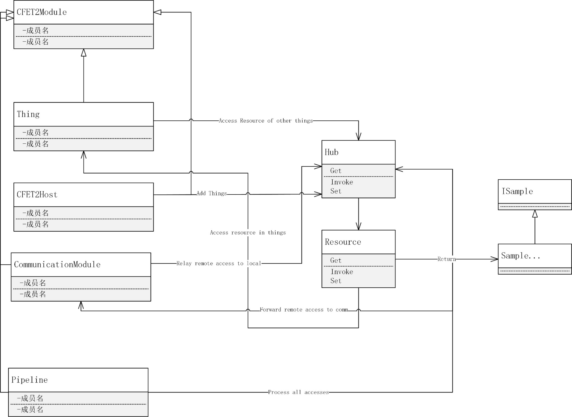
Overall view of CFET2 internals
Agent/Proxy

Slide 19
CFET2Module
Objects that consume CFET2 services
They access the CFET2 service from Hub
Thing
User implemented functions
Expose methods and properties resources
CFET2Host
The CFET2Module with highest privilege
Add things to the Hub
Communication Module
Like Hub for remote access
Pipeline
Process the sample returned by resources before t get to the requester

Slide 20
Resource
What is a resource?
It is a internal agent object that CFET2 used to manage access to the real properties and methods in the Things.
ResourceBase
ResourceThing
ResourceConfig
ResourceStatus
ResourceMethod

Slide 21
ResourceBase
Name
Path
The mount point + the name
IsOriginal
Reserved for future
ResourceType
Abstract, Thing, Status, Config, Method
Get
All types of resources support get

Slide 22
ResourceStatus
The single most important resource
PropertyGet
implementations
MethodGet
implementations
ParentResource
This is point to a ResourceThing
AddImplementation
Get: Property, Method with return value
Get
Array input
Dictionary input

Slide 23
ResourceConfig:ResourceStatus
PropertySet, MethodSet
Config Will also support insert, delete,
AddImplementation:
Set: Property with setter, method with at least one input parameter
Get: Property with getter, method with return value
GetSet(default): Property with getter and getter

Slide 24
ResourceMethod : ResourceStatus
AddImplementation:
Get: return invalid sample, this will be replace by a method info object
Invoke: any method

Slide 25
ResourceThing:ResourceBase
TheThing
Keeps a ref for the Thing it represents
Dictionary<string, ResourceBase> Resources
Contains all resources
ProbeTheThing
Get: returns invalid, but will return the thing detail

Slide 26
Sample
Sample are the response when you access a resource!
Why sample?
Return more then the resource value such as metadata, hypermedia etc.
Pipeline can modify the sample add more info
ISample
SampleBase
Config
Status
Method

Slide 27
ISample
object ObjectVal { get; }
TVal GetVal<TVal>();
bool IsValid{get; }
Dictionary<string, object> Context { get; } //Very importnat!!!
ISample AddErrorMessage(string msg);
string Path { get; }
ISample SetPath(string path);

Slide 28
Hub
Hub
It is a avatar of a HubMaster
For security reason
HubMaster
Singleton!

Slide 29
Hub
You can not new a Hub, it is injected to by inherit from CFET2Module
Pipeline, not correctly implemented by Chen Ming
EventHub, a hub for event, more on it later
TryAddThing
TryAddCommunicationModule
StartThings
StartCommunication

Slide 30
Hub
TryAccessResourceSampleWithUri(ResourceRequest request)
ResourceRequest(Hub hub, string uri,AccessAction action, object[] inputarray, Dictionary<string, object> inputdict, Dictionary<string, string> extraRequest, bool usingdict = false)
TryGetResourceSampleWithUri(string requestUri, params object[] inputs)
TryGetResourceSampleWithUri(string requestUri, Dictionary<string,object> inputDict)

Slide 31
URI
How URI is convert to thing path and parameters ??!!

Slide 32
Thing
TryInit(object initObj) //called when add to hub
virtual void Start() //called when hub.StartThings() is called, which is after all the things are added thus inited.
public string Path { get; internal set; }
public string GetPathFor(string resourceName)
{
return Path + @"/" + resourceName;
}

Slide 33
Event
Look for the document its very clear!

Slide 34
How to make a thing
Inherit from Thing
Cfet2ConfigAttribute
Cfet2MethodAttribute
Cfet2StatusAttribute
Then consume Hub and Hub.EventHub and Log
Example

Slide 35
CFET2APP
Config Log Provider
New a host
Add Thing
Add Communication
Start Commnication
Start Things
Listen to CLI

